Slide 1


REAL-TIME E-COMMERCE DATA PIPELINE AND ANALYTICS DASHBOARD
AP22110011165 G.Boaz

Slide 2

INTRODUCTION
Data Generation: Using the Faker library to create synthetic ecommerce data.
Data Streaming: Employing Amazon Kinesis to stream the generated data in real-time.
Data Processing: Leveraging AWS Lambda to process the streamed data.
Data Storage: Storing the processed data in an Amazon RDS PostgreSQL database.
Data Visualization: Analyzing and visualizing the stored data using Tableau and Power BI.

Slide 3
DATA GENERATION
Tool Used: Python Faker library.
Purpose: To simulate real-world ecommerce transactions, providing a realistic dataset for testing the pipeline.
Key Attributes: Each generated order includes an order ID, user ID, product ID, quantity, price, and order date.

Slide 4
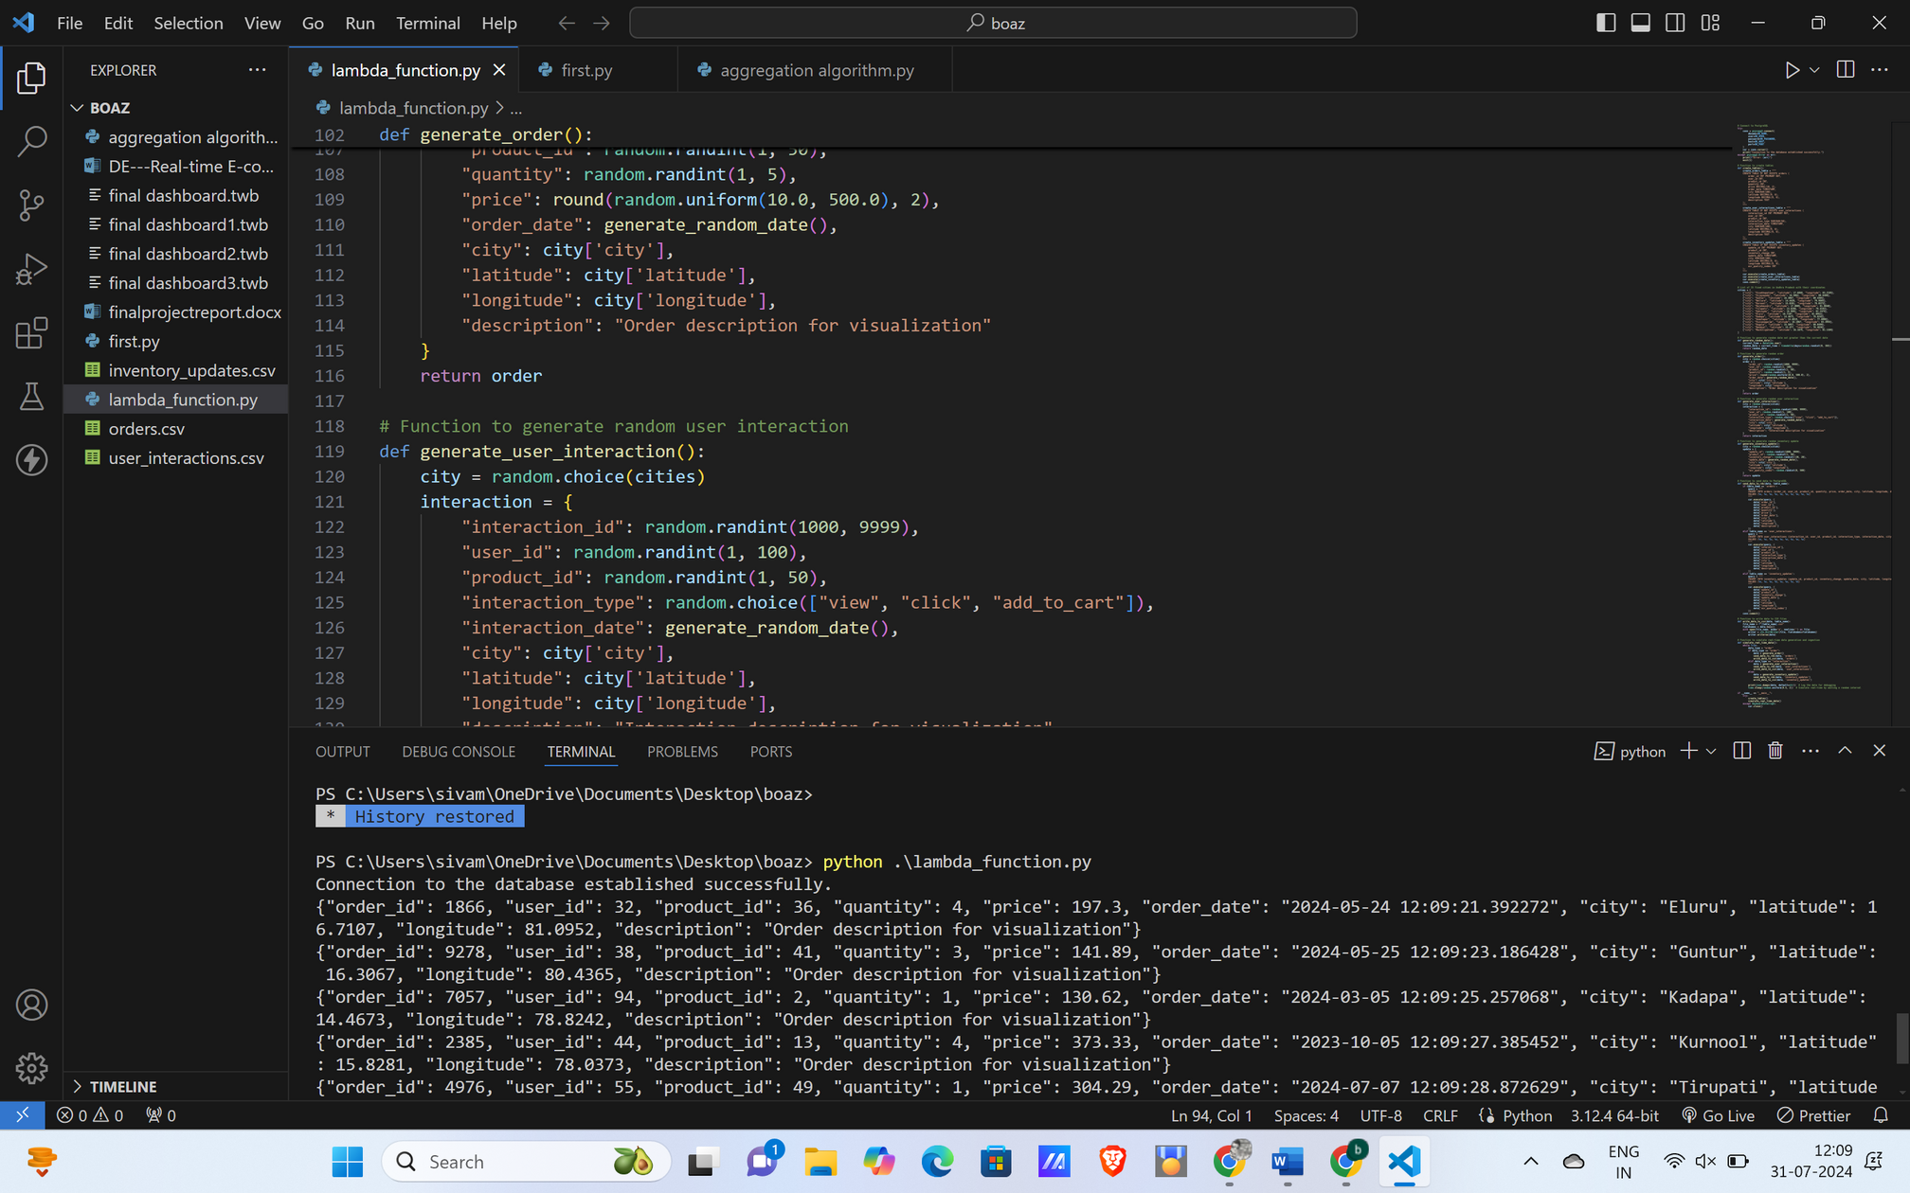
DATA GENERATION

Slide 5
DATA PROCESSING:
Service Used: AWS Lambda.
Purpose: To process incoming data from Kinesis. The Lambda function decodes the data and inserts it into the database.
Advantages: Serverless architecture, automatic scaling, and cost-effectiveness.

Slide 6
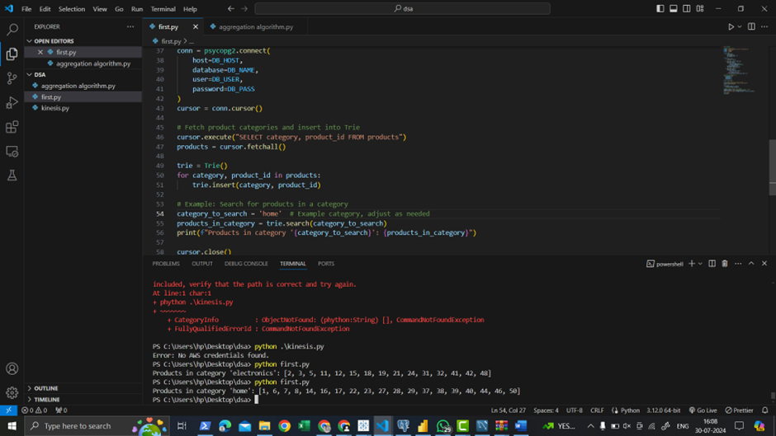
FOR PROCCESSING TIRE DS

Slide 7
DATA STORAGE:
Service Used: Amazon RDS PostgreSQL.
Purpose: To store the processed data securely and reliably.
Database Schema: Includes an ord

Slide 8
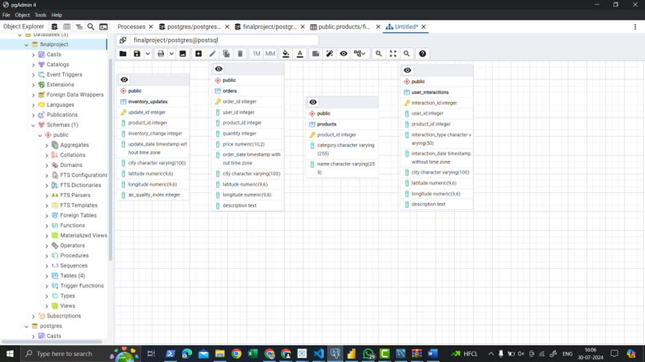
RDS SCHEMA

Slide 9
API GATEWAY:
Role: Facilitates HTTP requests to trigger the Lambda function for data processing.
Integration: Connects external applications with the backend processing function.

Slide 10
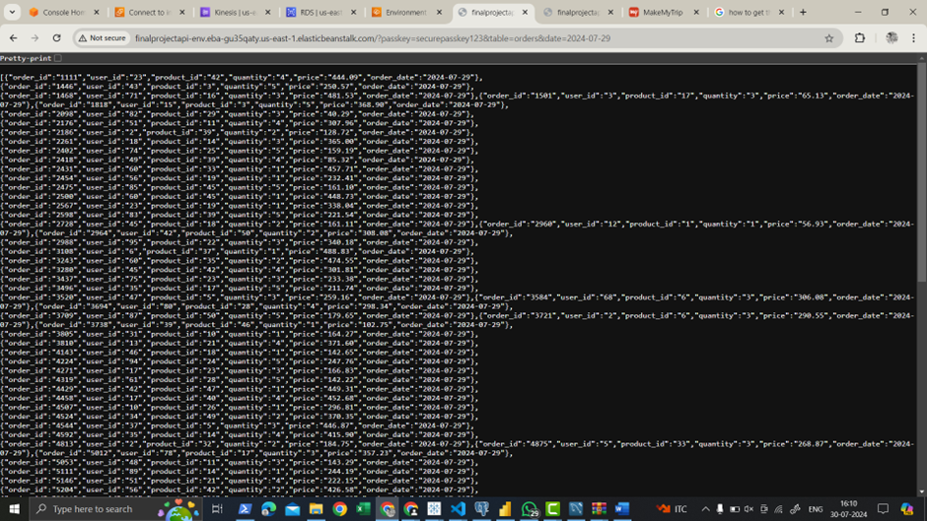
API FOR DATA RETRIVAL

Slide 11
DATA VISUALIZATION:
Tools Used: Tableau and Power BI.
Purpose: To create insightful dashboards and reports based on the stored data.
Benefits: Enhanced data analysis and decision-making capabilities through interactive visualizations.

Slide 12

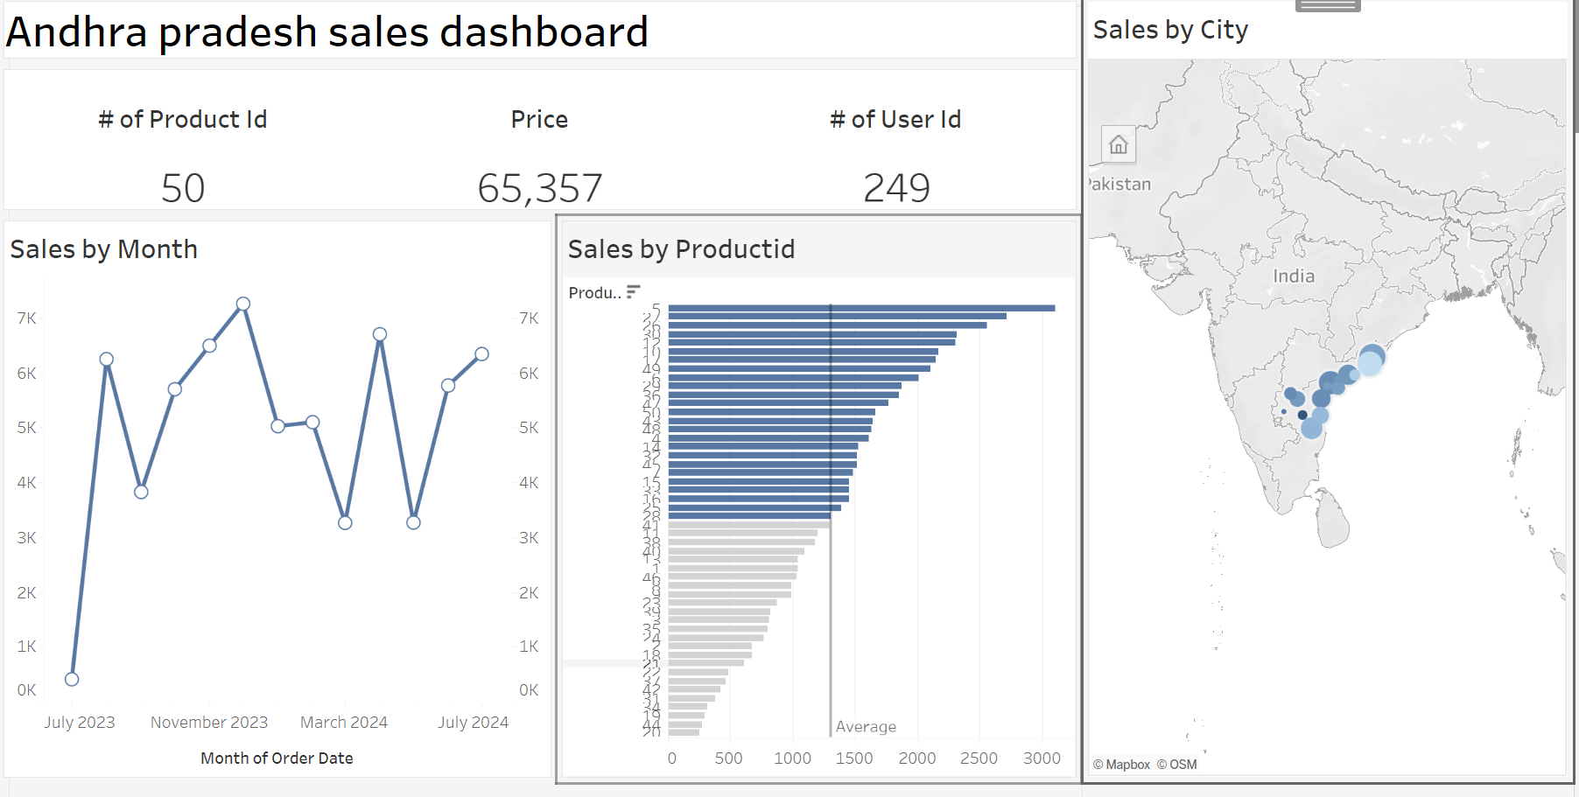
SALES IN OUR WEBSITE

Slide 13
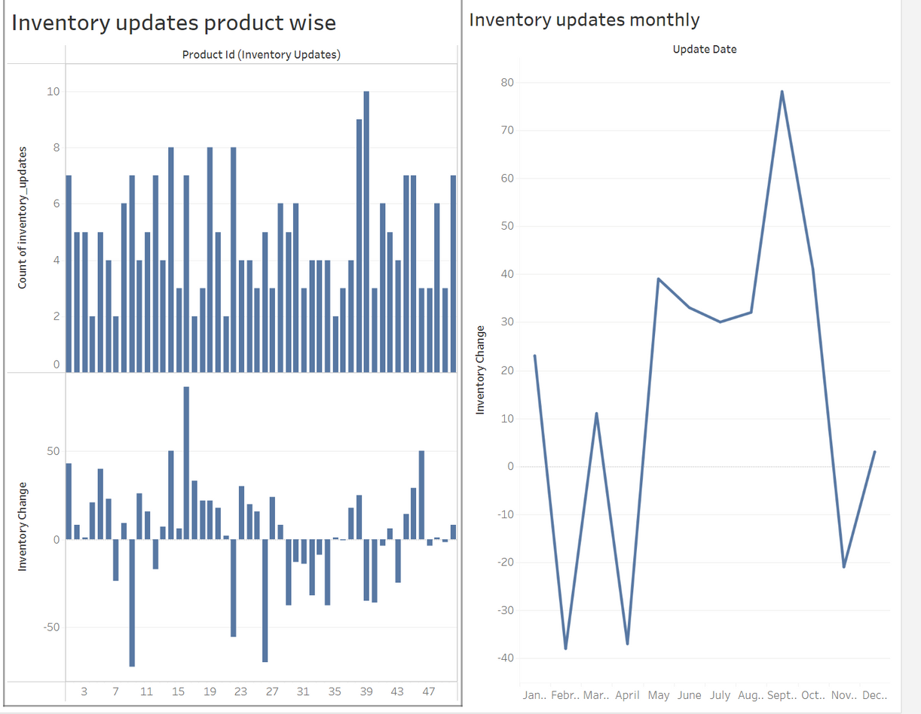
INVENTORY UPDATES PRODUCT WISE

Slide 14
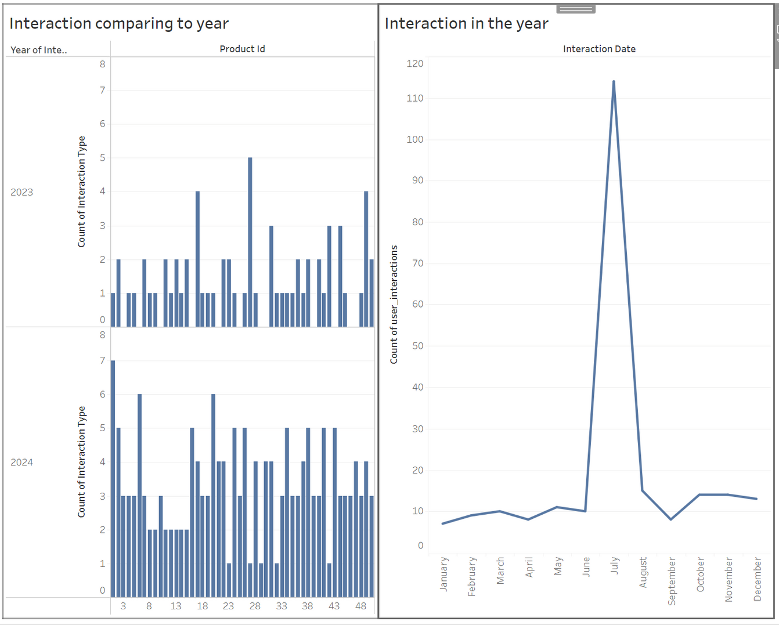
INTRACTING WITH WEBSITE

Slide 15
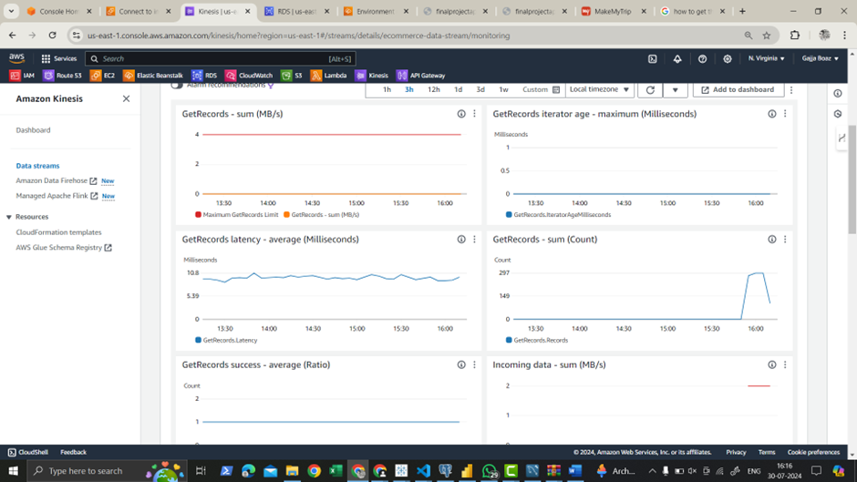
MONITORING THE ORDERS

Slide 16
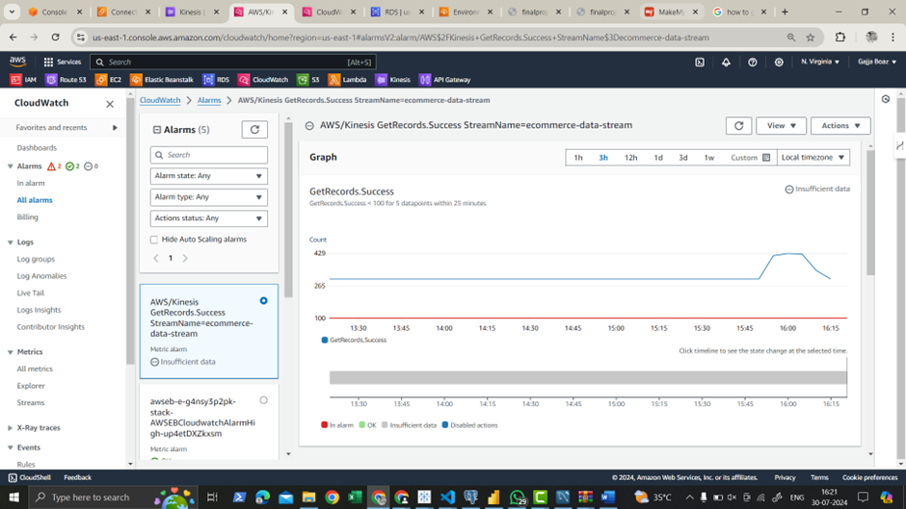
CLOUD WATCH FOR ERRORS

Slide 17
THANK YOU

